Slide 1


Summer 2026

Slide 2
Relevant Links
    Click on each “report title” to access the full version of each study.

Slide 3

Brookings Report Overview
Report: School Spending Equity since 1976 (2026)
Sarah Reber, Beyond Deng, and Gabriela Goodman
    “How does per-pupil spending differ depending on the poverty rate and racial composition of a district? How has that changed since 1976? What is the role of spending differences between and within states?”

Slide 4
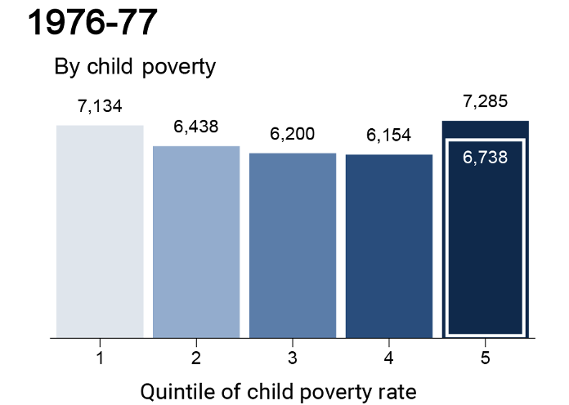
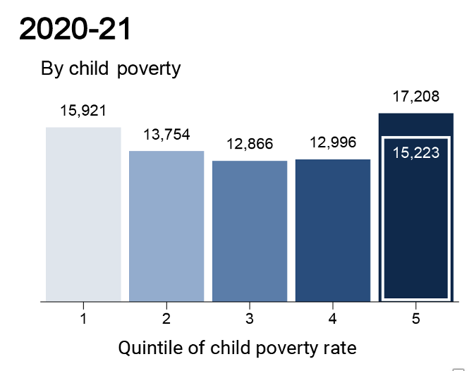
Brookings Report Findings

Slide 5
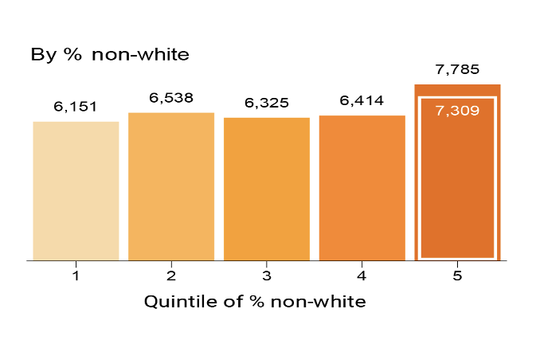
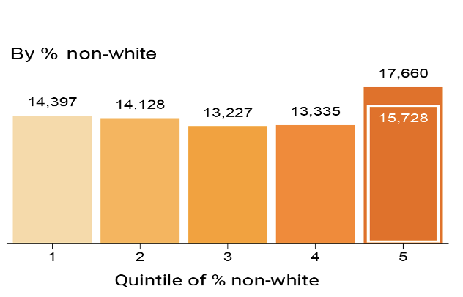


Brookings Report Findings

Slide 6

Urban Report Overview
Report: Do Poor Kids Get Their Fair Share of School Funding? (2017)
Feature: Which Students Receive a Greater Share of School Funding? (2022)
Report: How Did School-Level Expenditures Change in the Wake of the Pandemic? (2026)
“What is the average revenue per student, as experienced by the typical student from a household below the federal poverty level, compared to the average revenue experienced by the typical student from a non-poor household?”

Slide 7
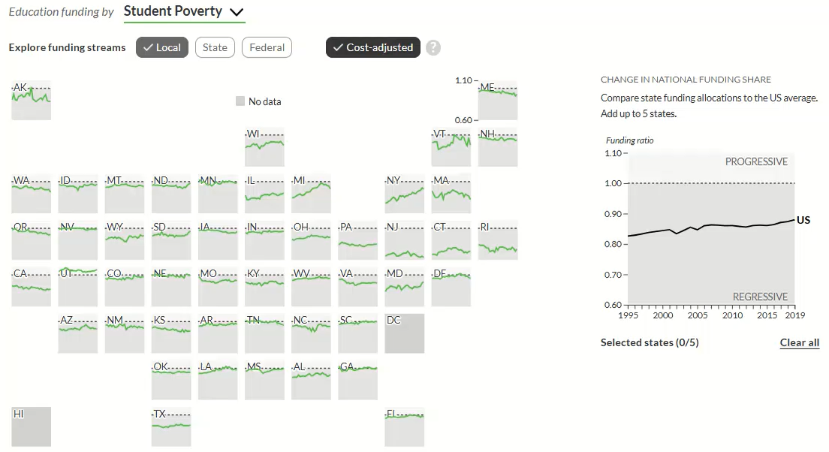
Urban Report Findings: District-Level, Poverty

Slide 8
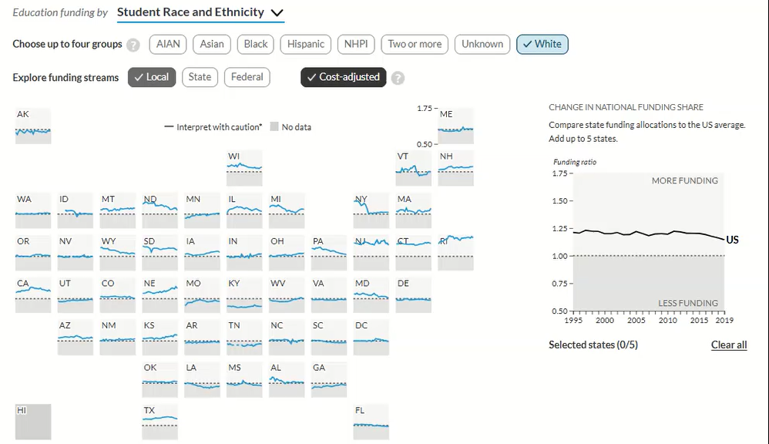
Urban Report Findings: District-Level, White/Non-white

Slide 9
EdBuild Report Overview
Report: $23 Billion (2018)
Nationally and within each state:
“What is the difference in per-pupil revenue between districts that serve predominantly (+75% concentration) white or nonwhite students? What is the difference between these groups when also factoring in poverty rates?”

Slide 10
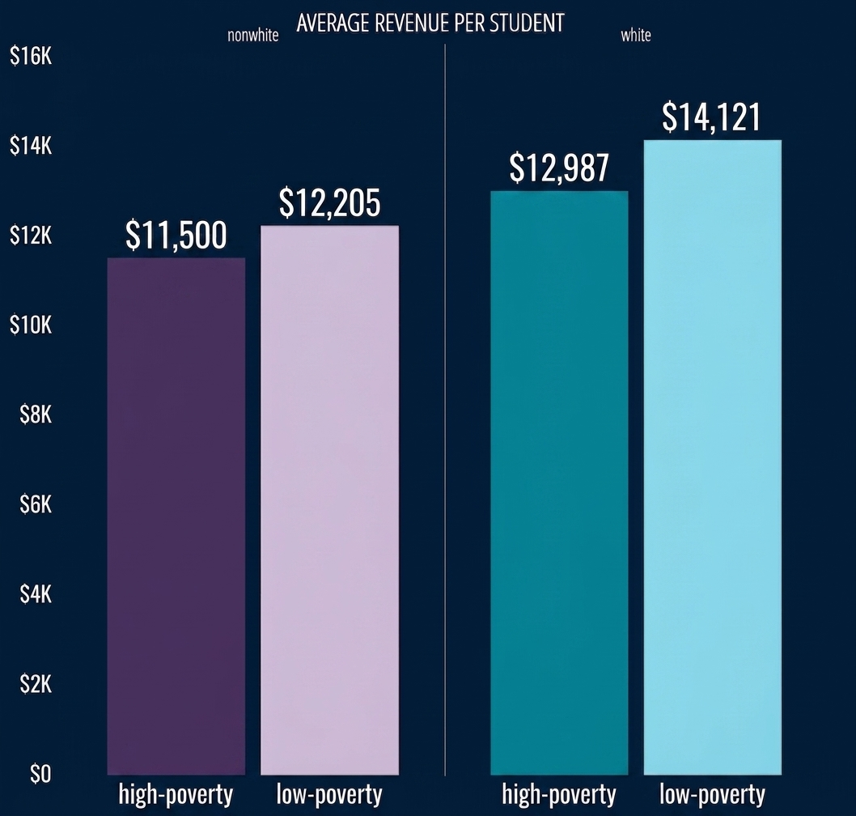
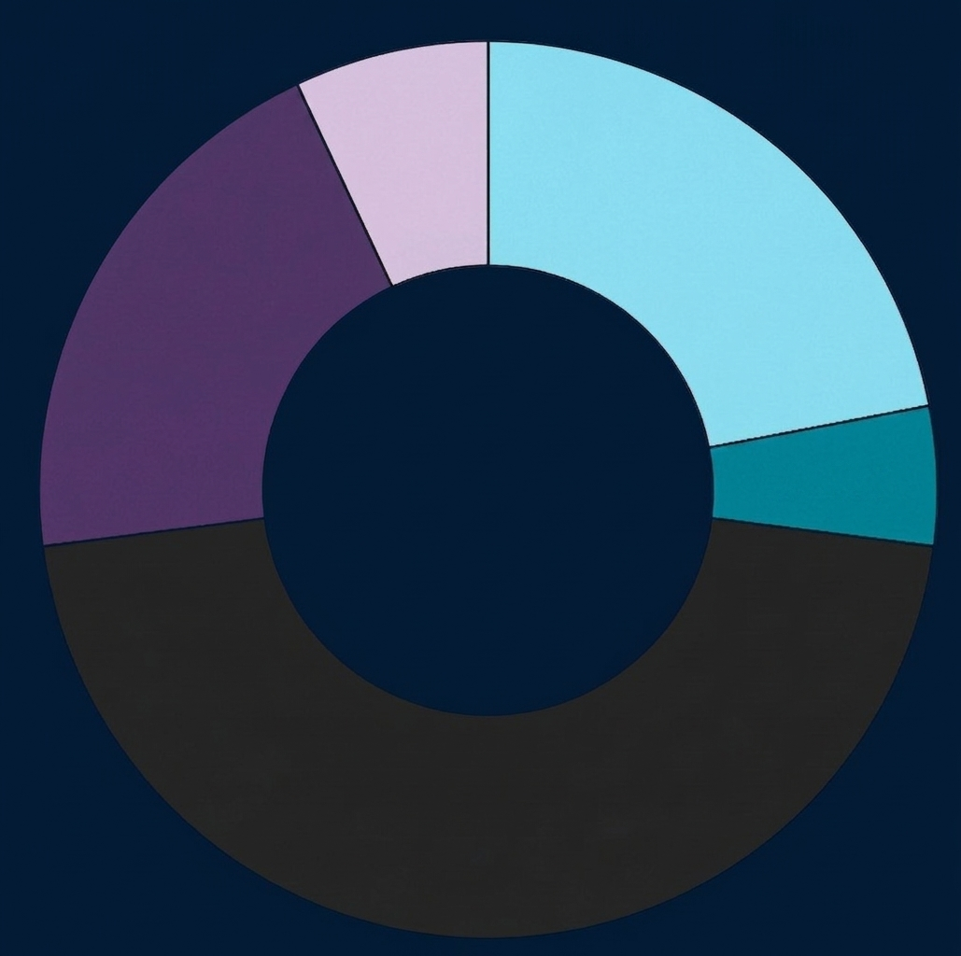
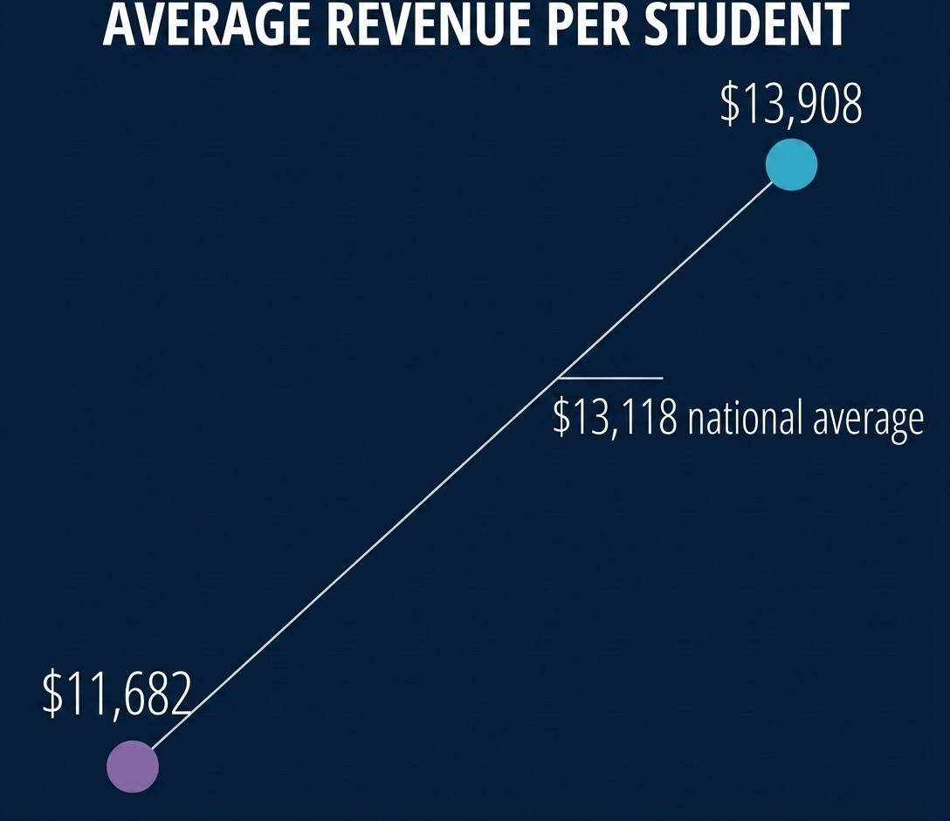
EdBuild Report Findings
STUDENTS IN EACH DISTRICT CATEGORY
AVERAGE REVENUE PER STUDENT
PR. NONWHITE PR. WHITE
PREDOMINANTLY
NONWHITE
PREDOMINANTLY
WHITE
7%
LOW-
POV
22%
LOW-
POV
20%
HIGH-
POV
5%
HIGH-POV
46%
INTEGRATED

Slide 11
At-a-Glance Comparison
Decision Point | Brookings | Urban | EdBuild
Federal Revenue | Included | Included in phases | Excluded
Cost of Living Adjustment | Unadjusted CWIFT in appendix | Yes, cost of labor (CWIFT) | Yes, cost of living (C2ER)
Unit of Analysis | Enrollment-weighted quintiles by white/nonwhite and poverty rate | Student-weighted averages by white/nonwhite and poverty rate | Six categories of districts (by share white/nonwhite and poverty rate)
Coverage | All districts (100% of students) | All students (100% of districts) | ~68% of districts (8,862); ~53% of students (25 million)
Time Period | Fall 1976 – Fall 2021 | Fall 1994 – Fall 2018 | 2016
All reports excluded school districts with no assigned geography. These are predominantly public charter schools.

