Slide 1


May 6th, 2025
Targeted Investments for Rural Students:
Findings from the Research
Emily Gutierrez, Urban Institute
Tony Pipa, Brookings Institution
Liza Schwartzwald, EdFund
Notes:
Emily Guiterrez: Senior Research Associate at Urban Institute in the Workforce Education and Labor Division. Research focuses on K-12 policies that occur outside the classroom but affect student success in the classroom.
Emily’s report, “Small and Sparse: Defining Rural School Districts for K–12 Funding” can be found here: https://www.urban.org/sites/default/files/2023-03/Small%20and%20Sparse-Defining%20Rural%20School%20Districts%20for%20K%E2%80%9312%20Funding.pdf
Tony Pipa: Senior Fellow at the Center for Sustainable Development at Brookings. Launched and lead an initiative to ensure federal policies are effective as possible in supporting remote and rural places across the U.S.

Slide 2
Rural Students: The Basics
About 1 in every 5 students attend school in rural districts
15 states have targeted investments for sparse school districts
Notes:
School districts that are in remote, rural, sparse areas face additional challenges. Existing challenges are exacerbated by geographical ones.
There are 15 states that fund for sparse districts. Click to the next slide to view them.

Slide 3
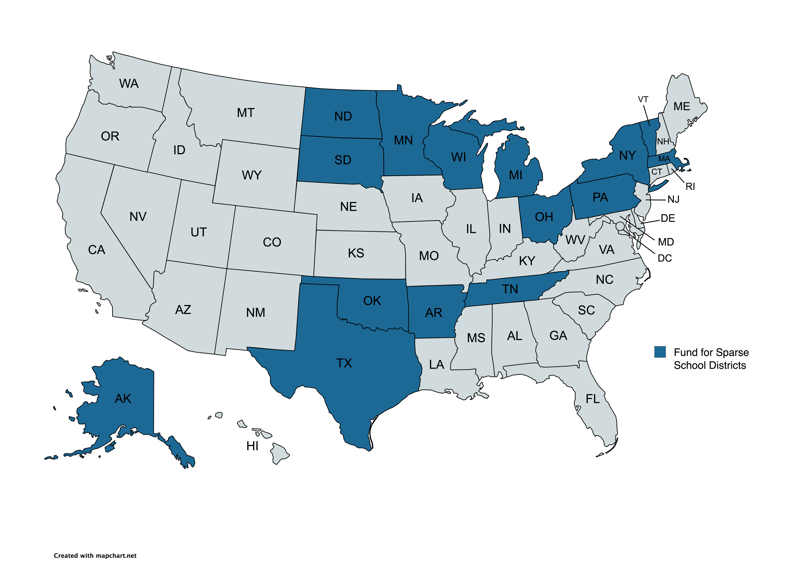
States That Fund for Sparsity
Notes:
Key questions:
What do we know to create a strong policy for these students?
What challenges do rural students face that could be addressed by additional targeted funding?

Slide 4
Challenges for Rural Communities
Lower Financial Base: Rural communities tend to have limited property tax revenue and less philanthropic support
Higher Costs: Costs for rural communities for things like transportation, infrastructure (e.g., broadband internet), and staffing can be higher
Staffing and Retention: Rural Communities may find it harder to attract and retain quality teachers and administrators
Fewer Resources: Rural communities may lack access to critical resources like healthcare
Notes:
Lower Financial Base: Rural areas have more limited property tax revenue, resulting in lower levels of local funding for schools. They also have less access to philanthropic resources. While 14% of the country is rural, only 3% of philanthropic funding is directed to these communities.
Higher Operating Costs and Infrastructure Challenges: Rural areas face higher transportation costs, increased costs for extracurricular activities, and longer travel distances. These factors contribute to infrastructure challenges, including significant gaps in broadband connectivity for rural communities and schools.
Staffing and Administrative Capacity: Teacher recruitment and retention are more difficult in rural areas, as is building adequate administrative capacity. Rural schools and local governments often have fewer staff available to manage programs and deliver services.

Slide 5
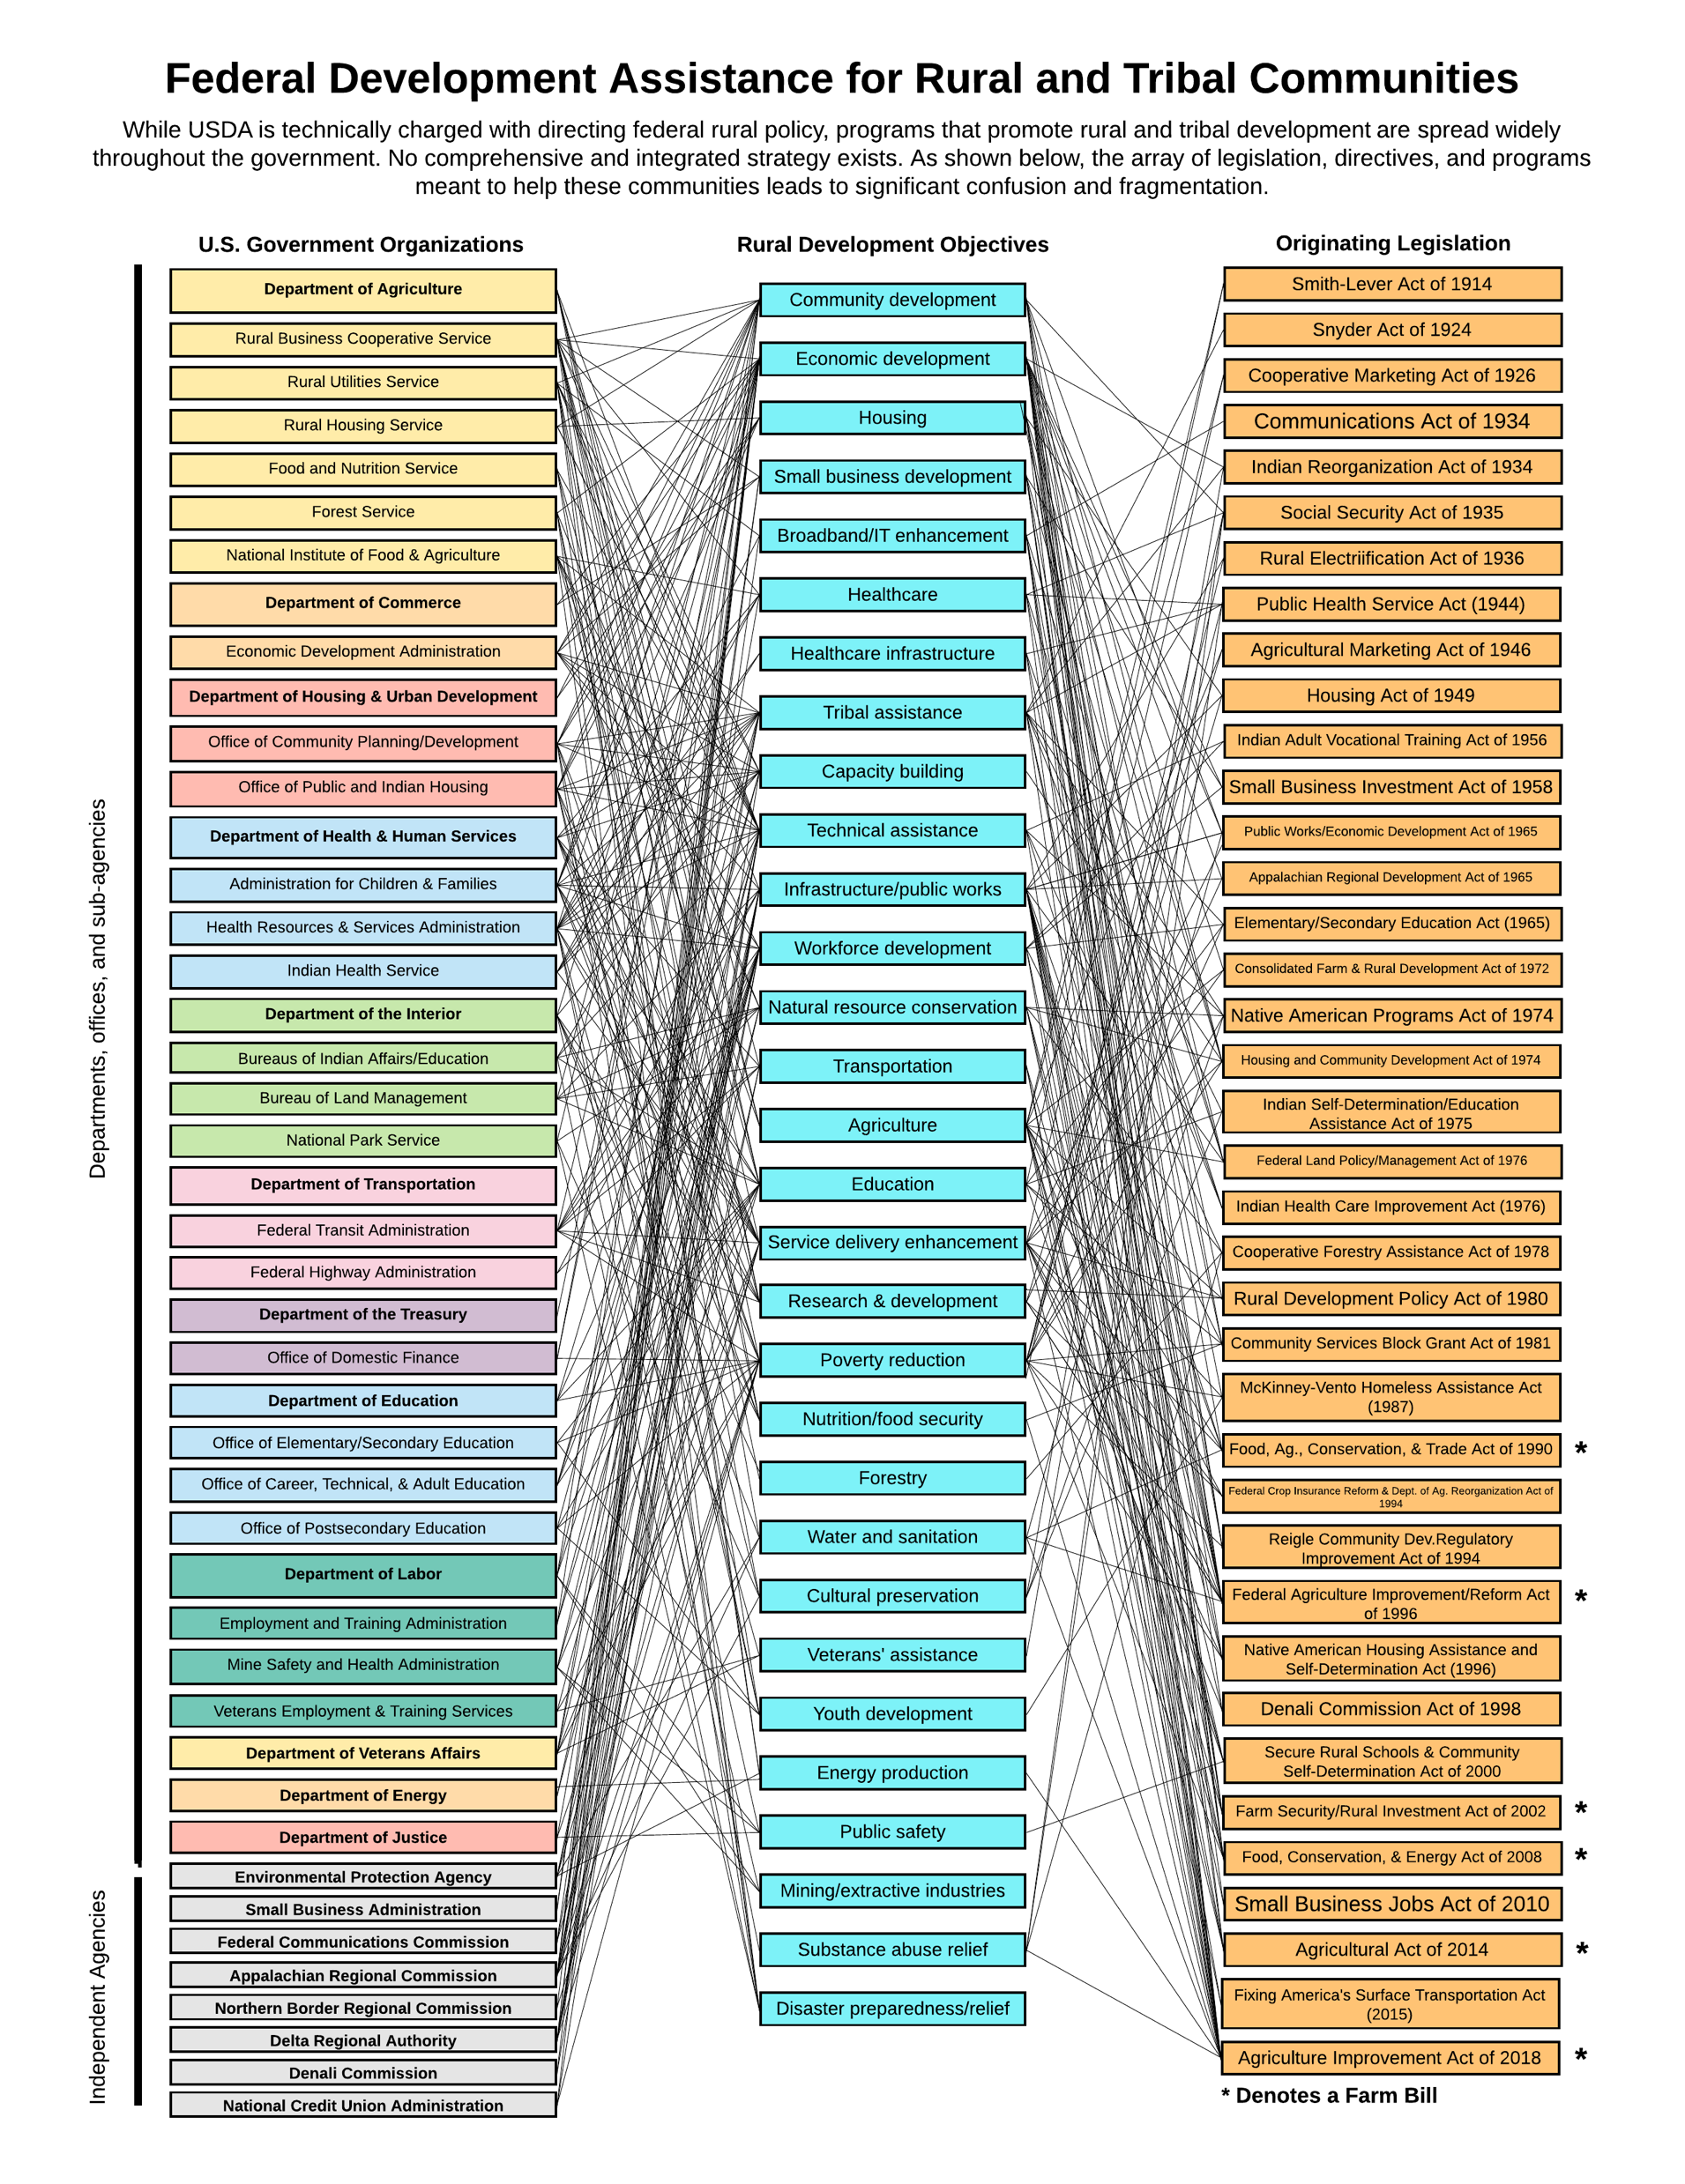
Federal funding for rural districts is incredibly fragmented and confusing, making it hard for low-capacity districts to know what supports they can access
Notes:
Here is a clean, professional rewrite with corrected grammar, clearer structure, and a polished tone:
“The Spaghetti Chart”: This chart illustrates the many offices and agencies from which funding originates. The left side represents where funding emanates, the right side reflects authorizing bodies and legislation, and the middle highlights development objectives (such as education and workforce development). On one hand, the chart shows that members of Congress are responding to the expressed needs of rural communities. On the other hand, for low-capacity communities trying to navigate, access, and manage these funds, the process is highly complex. This complexity makes it difficult for rural places to secure the resources needed to create thriving environments for students.
Additional Challenges: Individuals in rural communities are often stretched across multiple roles and responsibilities. Education is deeply interconnected with other aspects of rural life, including health care, employment, and community well-being. Rural communities tend to be “flat,” meaning there is little separation between education systems and the other services that sustain communities.
Pressure on Rural Systems: Rural communities face significant strain, particularly in health care. Many rural hospitals have closed, creating additional challenges for students and families. As a result, services that might otherwise be provided externally often fall to schools, increasing the burden on school leadership and administrative capacity.
Persistent Poverty: Eighty-five percent of persistent poverty counties are rural, defined as having poverty rates above 20% for more than 30 years. Many of these communities are shaped by extractive industries, which can lead to environmental toxins and pollution that negatively affect student health. These challenges are compounded by limited access to health care services.
Learn more about rurality and concentrated poverty in our podcast episode: https://open.spotify.com/episode/7vnvEkSfBCVL02rs3MZ0xy?si=L8XMeOBjRumwGC3cBDOPqA&nd=1&dlsi=eebaa41318da4cd7

Slide 6
Defining Rurality
Rural is an umbrella term. States may define what districts are rural differently.
Small Districts are defined by low enrollment
Sparse/Remote Districts are defined by distance or students per square mile
These distinctions matter because cost drivers can be very different depending on whether a school district is small, sparse, or remote.
Notes:
When we use the term rural, we are referring to an umbrella category that encompasses a wide range of contexts. At the federal level, definitions of rurality are typically based on U.S. Census classifications. At the state and district levels, however, definitions often need to be more student-centered, focusing on the characteristics and needs of the students being served. States also differ significantly in how they draw school district boundaries. For example, Florida and Nevada have relatively large school districts, while New York State has many small, locally governed districts.
In state funding discussions, an important question is how rural, small, and sparse districts are defined and differentiated:
Rural districts are often defined broadly and may vary by state.
Small districts are typically defined by low student enrollment.
Sparse or remote districts are defined by geographic distance or low student density (for example, students per square mile).
These distinctions matter because the underlying cost drivers can differ substantially depending on whether a district is small, sparse, remote, or rural, which has important implications for state funding formulas and policy decisions.

Slide 7
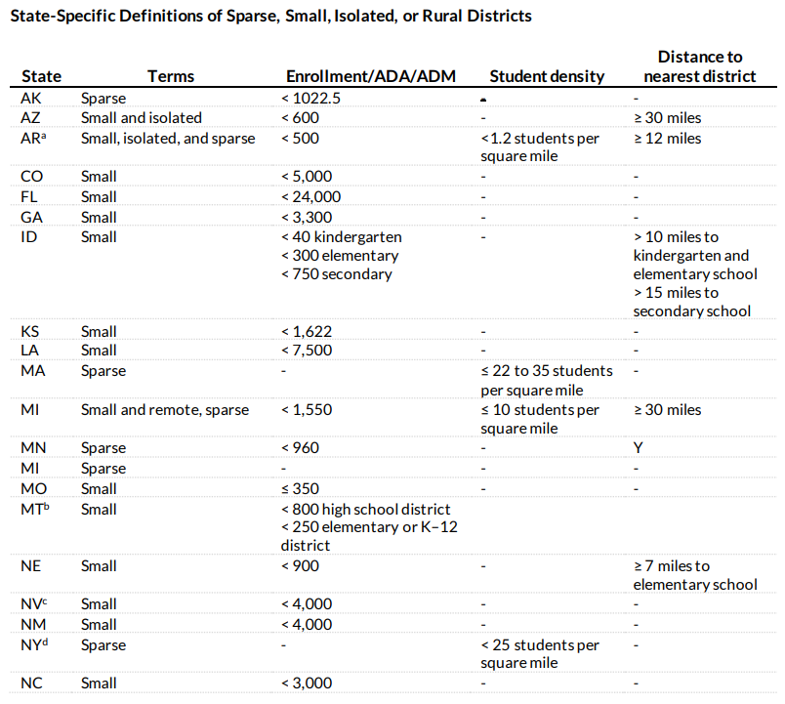
States use different definitions to identify sparse, small, isolated, or rural districts
Notes:
Cost Drivers in Rural and Sparse Areas
Regardless of whether a district serves five students or 2,000, schools still require core infrastructure, including a building, a principal, and teachers. In larger districts, these fixed costs can be spread across more students. In smaller or rural schools, however, fewer students make it much harder to distribute these costs efficiently.
Labor markets in rural areas are often thin, making it difficult to recruit and retain teachers. As a result, districts may need to offer higher compensation to attract staff, even when local funding is insufficient to support those costs.
In sparse or remote areas, transportation is a major cost driver. Long bus routes, extended travel times, and geographic isolation all increase the expense of getting students to and from school.
There is also an “input crisis” in rural areas. Schools may need to transport basic supplies over long distances, and many communities lack access to essential student supports, such as mental health services, telehealth, or specialized programs.
Sparsity further limits local funding capacity—not only because of lower community wealth, but because local property tax bases are spread across large geographic areas. Fewer students per square mile means fewer local dollars, even as per-student needs increase.
The Broader Impact of Targeted Funding
Targeted investments in rural schools can have benefits that extend beyond individual students to the broader community. Smaller class sizes can foster stronger relationships among students and staff, which can be a significant asset. In many rural communities, schools serve as the central and most trusted institution.
Schools often function as hubs for service delivery, providing access to health care, dental services, libraries, and other community resources. They may also serve as gathering places where people from different economic backgrounds interact, making schools anchor institutions within rural communities.
The strength of a rural community’s economy is closely tied to the quality of life it can offer its residents, and schools play a central role in that equation. The sense of kinship students feel toward their schools can help encourage young people to return to their home communities, supporting long-term vitality. Attracting and retaining youth is a significant challenge for rural areas, and schools are a critical lever in addressing it.
Recognizing the Diversity of Rural Communities
Rural communities are not monolithic. What qualifies as “rural” in one state may look very different in another. For example, rural Texas and rural Alaska face vastly different conditions, needs, and cost structures. Funding policies must account for this diversity and be grounded in the specific realities of place, rather than relying on a one-size-fits-all definition of rurality.

Slide 8
Studies on Cost Drivers
Takeaway #1: District-need cost factors, such as enrollment and sparsity, are crucial to consider in addition to student need cost factors that affect a child's effort and ability to master academic subjects.
Takeaway #2: Remote, rural districts spend substantially more on capital, facilities, and debt service and relatively little on student spending
Takeaway #3: Funding for additional cost drivers in sparse, rural, and remote districts can help schools meet their cost of service.
Baker, B., & Duncombe, W. (2004). Balancing district needs and student needs: The role of economies of scale adjustments and pupil need weights in school finance formulas. Journal of Education Finance, 29(3): 195-221.
Dhaliwal, T. K., & Bruno, P. (2021). The rural/nonrural divide? K–12 district spending and implications of equity-based school funding. AERA Open, 7(1): 1-21.
Notes:
Emily curated the Rural Students section of EdFund’s Research Library: https://corpus.ed-fund.org/education-finance-research-library
Much of the existing research relies on Census definitions of rurality, with some overlap between those definitions and the criteria states use in their school funding formulas. Looking ahead, it would be valuable for research to place greater emphasis on defining and analyzing sparsity, in particular.
The research suggests that enrollment adjustments are often necessary for districts serving roughly 2,000 students or fewer. Rural districts also tend to spend a higher share of their budgets on capital investments. When districts receive additional funding, those dollars are frequently used first to maintain facilities, before being directed toward more student-centered supports, such as increased per-pupil spending.
Considerations for Policymakers
Policymakers should recognize the central role rural schools play in the economic, social, and cultural fabric of their communities. Research and policy discussions should expand beyond consolidation-focused approaches and explore alternative strategies.
Key considerations include:
Assessing whether state funding formulas include a sparsity adjustment and examining relative levels of sparsity within the state.
Engaging districts to understand what questions they are trying to answer—and what challenges they are trying to solve—with additional funding.
Exploring partnerships as an alternative to consolidation, including school-to-school collaborations or partnerships between schools and other entities, such as forestry services.
Investing in forward-looking supports that help rural districts build administrative capacity before they reach critical constraints.
These approaches can better align state policy with the unique needs and strengths of rural school systems.

Slide 9
Why are costs different based on which definitions states use?
Small Schools: Economies of scale mean that fixed costs like principals, building construction, and teachers will cost more per-student for smaller schools.
Sparse/Remote Schools: Sparse and/or remote schools face higher transportation costs, input prices, and service delivery costs.
Notes:
Emily

