Slide 1


April 9th, 2025
From Ratings to Reality
School Bonds and Credit Ratings for Local School Districts
Kate Yang, George Washington University
Emilio Flores, Caldwell Flores Winters, Inc.
Shrien Alshabasy, EdFund
Notes:
Kate Yang is an associate professor at the Trachtenberg School of Public Policy and Public Administration at George Washington University. Her research interest is in state and local government finances. Her recent publications examine how states address local government fiscal stress through monitoring, intervention, and bankruptcy authorizations. Further, she examines the incentives and impediments to government financial reporting, disclosure, and transparency. Lastly, she studies education finances in the United States, especially school district borrowing and fiscal responses to shocks.
Emilio Flores is the Chief Executive Officer of Caldwell Flores Winters, Inc., a California- based multidisciplinary consulting firm that provides California school districts with facilities planning, municipal advisory, and program management services. Mr. Flores is a registered municipal advisor and has participated in over 150 municipal securities transactions related to general obligation bonds, certificates of participation, lease revenue bonds, short-term notes, and other school facilities financing methods. He assists school districts in the issuance of debt including the establishment of capital programs, recommendations regarding the timing and structuring debt, the procurement of credit ratings and enhancements, and the pricing of municipal securities.
This conversation is a discussion between Kate and Emilio focused on school facilities funding and the bond market.
The goal of the session is to demystify how school districts borrow money, how bonds work, and why access to capital matters for school conditions.

Slide 2


The bond process
A school needs financial support for capital expenditures
They propose a budget and the local vote determines whether or not it is approved.
If it’s approved, what happens next?
Notes:
Emilio explains that bonds are a primary way school districts finance large capital projects, such as building new schools or making major renovations. He describes the bond market as the mechanism through which districts borrow money from investors and repay it over time with interest. Emilio notes that districts do not pay for school buildings all at once; instead, bonds allow costs to be spread across many years so current and future taxpayers share responsibility

Slide 3
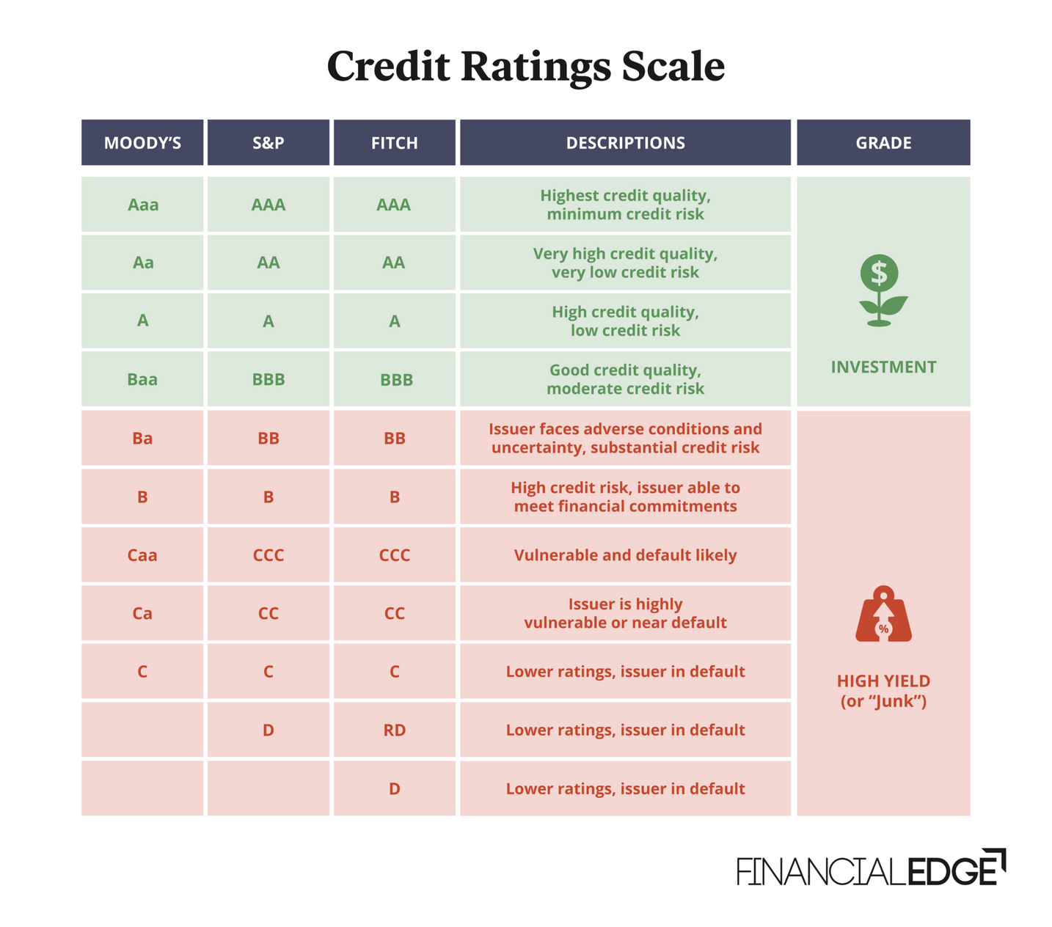
Key factors and criteria in determining credit worthiness
Notes:
Emilio discusses how a district’s creditworthiness affects borrowing costs, with stronger credit ratings leading to lower interest rates. Emilio highlights that wealthier districts often have easier access to the bond market, while lower-wealth districts may face higher costs or additional barriers. He stresses that these differences in access can translate directly into unequal school facilities and learning environments for students.

Slide 4
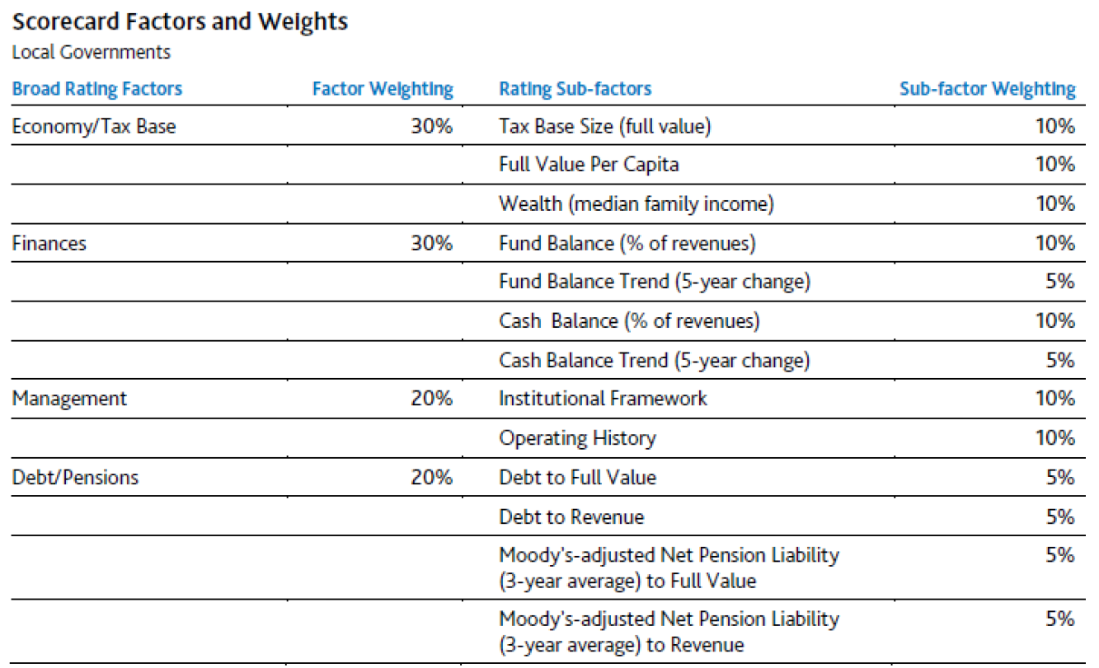
Moodys Score Card
Notes:
Moody's Scorecard is a tool that helps users quickly generate credit risk profiles and perform scenario analysis based on Moody's Ratings methodologies and qualitative inputs.

Slide 5
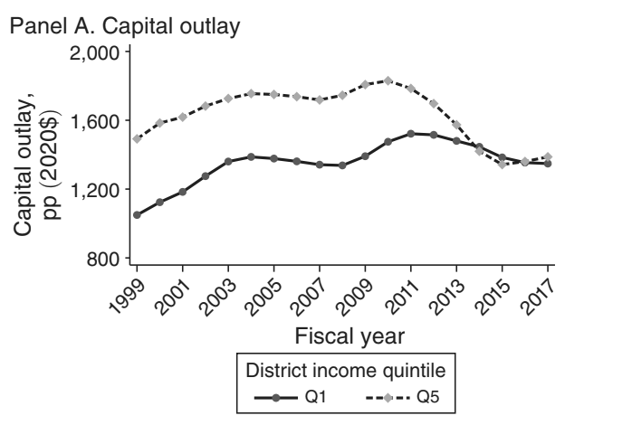

What are some significant historical events that could affect the data that researchers have on capital investments?
Notes:
Kate explained that major economic downturns, particularly recessions, can significantly affect capital investment data by delaying or canceling school construction projects. She noted that the Great Recession is especially important for researchers to account for, as many districts paused or sharply reduced capital spending during that period.
Kate pointed out that bond markets themselves can tighten during economic crises, making it harder or more expensive for districts to borrow, which shows up as drops or irregularities in capital investment data. She also highlighted that changes in interest rate environments over time can distort comparisons across years, because the same level of borrowing may translate into very different amounts of actual construction.
Kate emphasized that policy changes, such as the introduction or expansion of state credit enhancement programs, can create structural breaks in the data that researchers need to account for. She cautioned that without considering these historical events and policy shifts, researchers may misinterpret trends in capital spending or attribute changes to the wrong causes.

Slide 6
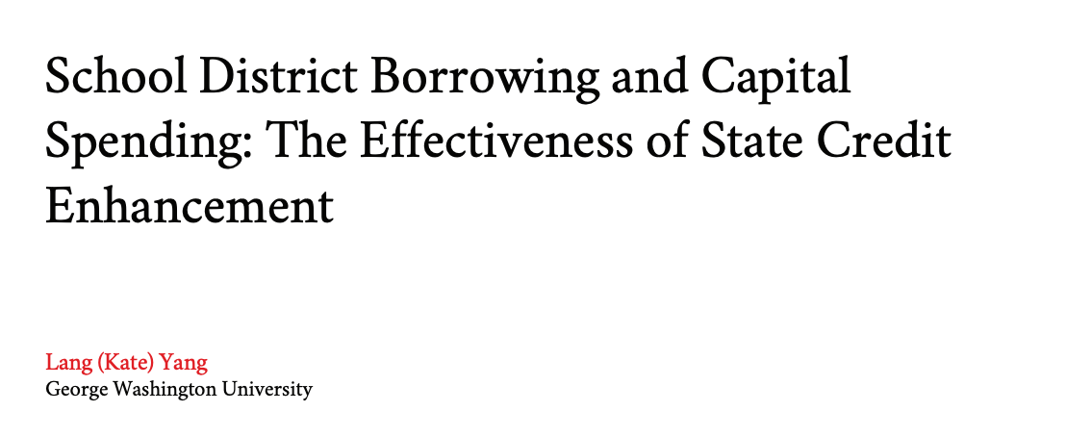
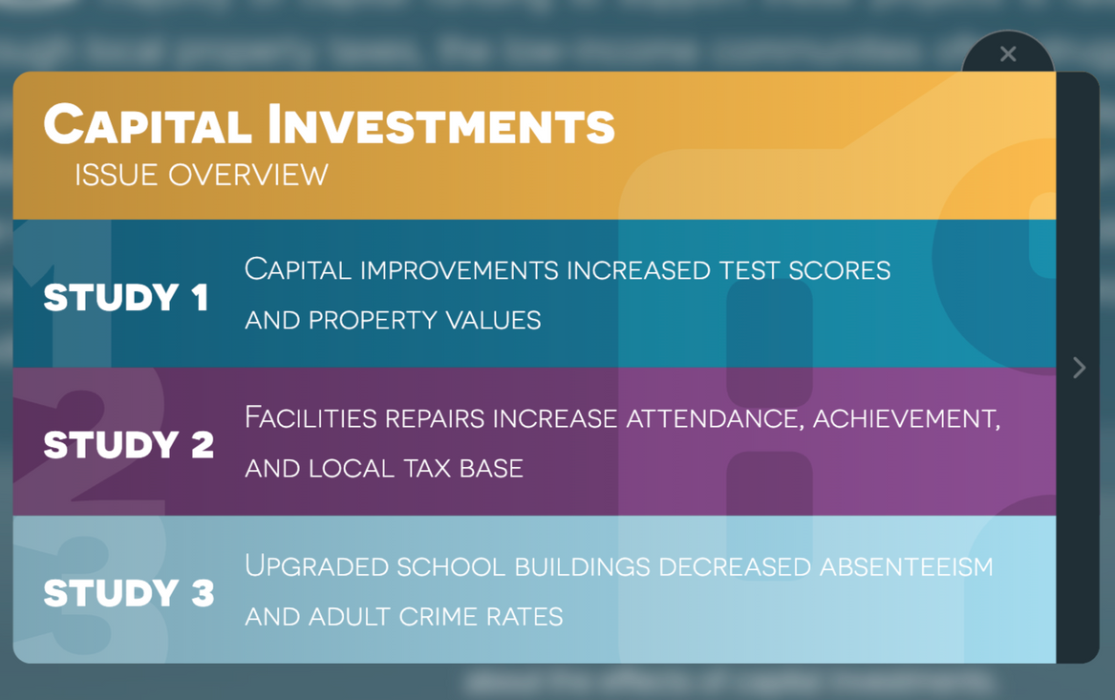
How does state enhancement impact district bond interest rate, per-pupil capital spending, and student performance?
Notes:
Kate explained that state credit enhancement lowers borrowing costs by allowing districts to access the bond market under stronger credit conditions than they could achieve on their own. She emphasized that when interest rates are lower, districts are able to direct a greater share of borrowed dollars toward actual construction and repairs rather than debt service. Kate noted that this translates into higher per-pupil capital spending, particularly in districts that would otherwise be constrained by weak tax bases or lower credit ratings. She was careful to clarify that credit enhancement does not directly improve student achievement, but instead works through the quality of school facilities.
Kate highlighted that improved facilities contribute to healthier and safer school environments, which research associates with better attendance, fewer disruptions, and stronger student engagement. She framed state credit enhancement as a mechanism for reducing inequality, arguing that it helps ensure students’ learning environments are not determined by local wealth.

Slide 7
Joint Discussion
Notes:
Credit enhancement refers to tools or mechanisms that improve a school district’s perceived creditworthiness in the bond market, allowing the district to borrow at lower interest rates. The speakers explain that credit enhancement is especially important for districts with lower property wealth or weaker tax bases, which would otherwise face higher borrowing costs. One common form of credit enhancement discussed is state backing or moral obligation support, where the state signals that it will step in if a district struggles to repay its debt.
By reducing perceived risk for investors, credit enhancement can substantially lower interest rates, saving districts millions of dollars over the life of a bond. The speakers emphasize that without credit enhancement, two districts borrowing the same amount for the same type of school facility can end up paying dramatically different total costs.
Credit enhancement is framed as an equity lever: it does not increase how much a district borrows, but it changes the terms under which districts are allowed to borrow. The conversation highlights that states play a critical role in determining whether credit enhancement programs are available and how broadly they are used. When designed well, credit enhancement helps level the playing field between wealthier districts and districts serving lower-income communities. The speakers note that these policies often operate in the background, meaning their impact is large but not always visible to the public.
Ultimately, credit enhancement is described as one of the most effective policy tools for improving access to safe, modern school facilities without requiring new local taxes.

Slide 8
Q&A
Notes:
During the Q&A portion of the webinar, participants asked clarifying questions about how school districts navigate the bond process once a bond is approved by voters. The speakers explained that approval is only the beginning; districts must still work with financial advisors, underwriters, and legal counsel to issue bonds and manage repayment responsibly.
Several questions focused on equity, particularly how states can support districts that consistently struggle to pass bonds due to low property wealth or voter constraints. In response, the speakers reiterated the importance of state-level interventions, including credit enhancement programs, matching funds, and centralized facilities support.
One question raised concerns about transparency and whether communities understand the long-term costs associated with bond borrowing. The speakers acknowledged that bond financing can be opaque and emphasized the need for clearer public communication about interest costs, timelines, and total repayment amounts.
Participants also asked how rising interest rates affect districts’ ability to finance facilities projects. The speakers noted that higher rates disproportionately affect lower-wealth districts and make credit enhancement and state support even more critical in volatile market conditions. The Q&A closed with discussion about policy momentum, with speakers expressing cautious optimism that more states are beginning to view facilities funding as a statewide responsibility rather than a purely local one.

