Slide 1


March 25th, 2025
Building Brighter Futures:
How School Facility Investments Drive Student Success
David Schönholzer, UC Santa Cruz
Kate Yang, George Washington University
Liza Schwartzwald, EdFund
Notes:
This session is part of EdFund’s Building Brighter Futures series and focuses on connecting research on school facilities funding to policy decisions. The webinar format includes audience questions submitted through the Q&A feature, which are addressed later in the discussion.

Slide 2
Facilities: The Basics
In 2019-2020, U.S. spent $90B on construction and renovation of facilities.
Roughly 3/4s of capital outlays are funded locally.
This includes: Classroom construction and renovation, HVAC, infrastructure, safety and health, technology, IT, and laboratory spaces, athletic facilties, and transportation
Notes:
School facilities include classroom construction and renovation, HVAC systems, safety and health infrastructure, technology and IT, laboratory spaces, athletic facilities, and transportation. In 2019–2020, the United States spent approximately $90 billion on construction and renovation, with roughly three-quarters of capital outlays funded locally.
Facilities are a core but often overlooked component of school finance. Because funding is largely local, differences in community wealth lead to unequal school building conditions. The physical condition of school facilities affects student learning, health, safety, and overall well-being.

Slide 3
What Works and For Whom? Effectiveness and Efficiency of School
Capital Investments Across the U.S.
Barbara Biasi, Julien Lafortune, David Schönholzer
Takeaway #1: Spending on school bonds is both effective and efficient. Investments in facilities improved student test scores and property values.
Takeaway #2: Closing the facilities spending gap between high-income and low-income districts and targeting the additional funds towards HVAC and safety/health could reduce the gap in test scores by up to 25%
Notes:
National research examines the effectiveness and efficiency of school capital investments across the United States. The analysis uses variation in school bond authorization to estimate causal effects on student outcomes and community impacts.
Spending on school bonds improves student test scores and increases property values. These findings indicate that facilities investments generate educational benefits while also being valued by local communities.
Reducing the facilities spending gap between high-income and low-income districts and directing additional funds toward high-impact projects—especially HVAC and safety or health investments—could reduce test score gaps by up to 25 percent.

Slide 4
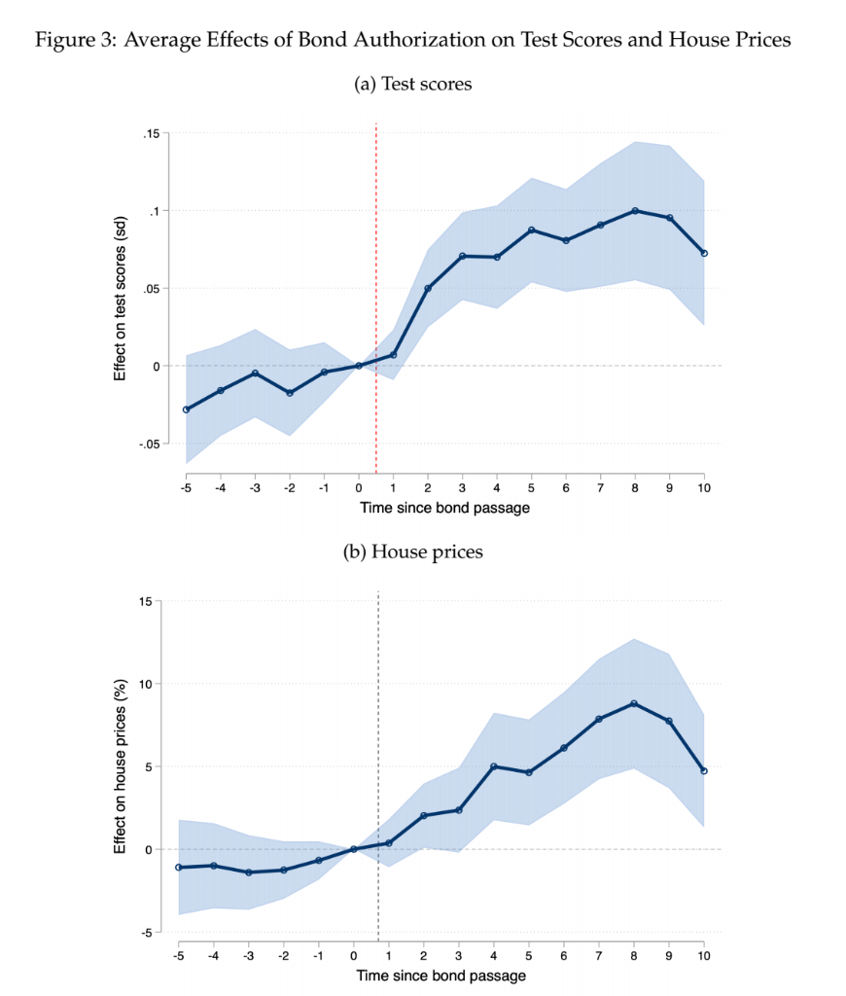
Average Effects of Bond Authorization on Test Scores and House Prices
Notes:
Districts that narrowly pass bond measures experience sustained improvements in student achievement compared with districts that narrowly fail. Housing values also rise following bond passage, reinforcing evidence that facilities investments are economically efficient.

Slide 5
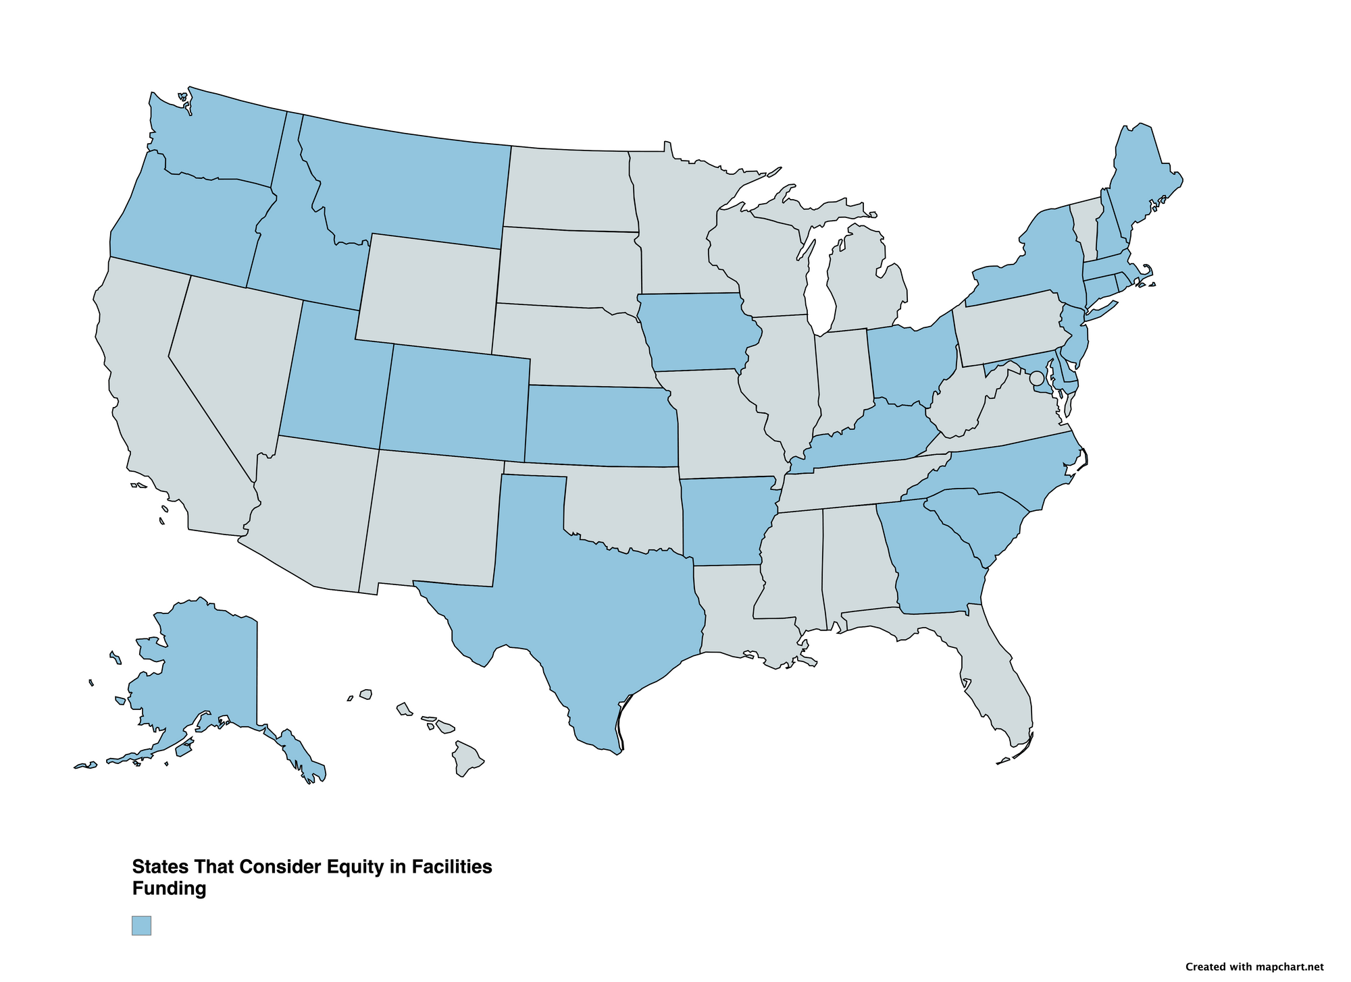
Notes:
This map shows the states that incorporate equity considerations into their school facilities funding policies. States highlighted have mechanisms that account for factors such as community wealth, property values, or existing facility conditions when allocating capital resources.
States shown in gray do not systematically consider equity in facilities funding, meaning access to capital improvements depends more heavily on local revenue capacity. This creates uneven school building conditions across districts within and across states.
The map illustrates that equity-focused facilities policies are not universal and vary widely across the country. Even where equity is considered, the strength and design of these policies differ significantly.
Because most facilities funding is raised locally, state-level equity policies play a critical role in offsetting disparities tied to property wealth. States that explicitly consider equity are better positioned to direct resources toward districts with the greatest needs.

Slide 6
Discussion
Notes:
Facilities outcomes are shaped not only by investment decisions but also by how districts finance capital projects. Bond financing and access to credit play a central role in determining what districts can build and at what cost.
School districts typically rely on municipal bonds to finance capital projects. Borrowing costs vary widely across districts and depend on perceived creditworthiness in the bond market.
State credit enhancement programs support or back local school bonds, improving credit conditions and lowering interest rates. These programs expand access to capital, particularly for districts with limited local tax capacity.

Slide 7
School District Borrowing and Capital Spending: The Effectiveness of State Credit Enhancement
Kate Yang
Takeaway #1: State enhancement narrows the gap in capital spending by about 25%.
Takeaway #2: Districts in states without credit enhancement programs could have achieved cost savings in the range of $383 million to $1 billion from 2009 to 2019 had the states adopted similar programs.
Notes:
State credit enhancement reduces gaps in per-pupil capital spending by approximately 25 percent, helping equalize districts’ ability to invest in school facilities. Districts in states without credit enhancement programs could have achieved substantial cost savings—estimated between $383 million and $1 billion from 2009 to 2019—if similar programs had been adopted. By lowering borrowing costs and increasing access to capital, state credit enhancement can improve the quality and timing of facilities investments, supporting better learning environments for students.

Slide 8
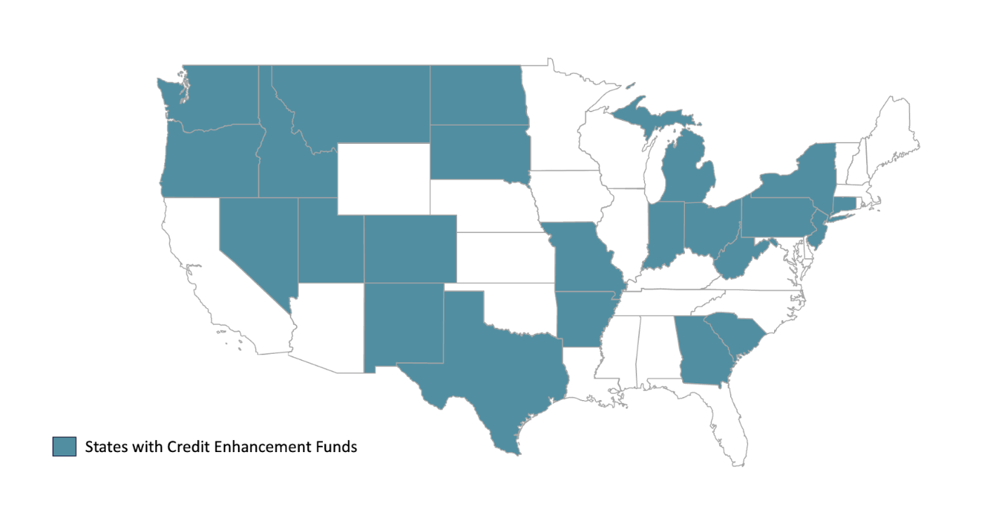
Notes:
This map shows the states that operate credit enhancement funds for school district bonds. States shown in color have mechanisms in place to back or support local school bonds, which can lower interest rates and reduce borrowing costs for districts. States shown in white do not have these programs, meaning districts rely more heavily on local property wealth and market perceptions of risk when issuing bonds.
The map highlights significant geographic variation in access to credit enhancement. This uneven policy landscape contributes to differences in districts’ ability to finance school facilities.

Slide 9
Q&A & Closing Remarks
Notes:
Investments in HVAC systems and safety-related infrastructure deliver especially strong academic returns. Other types of facilities projects may yield fewer direct benefits for student learning.
State involvement plays a critical role for districts with low property wealth by offsetting structural disadvantages in local tax bases and improving access to affordable financing.
Equitable and well-targeted facilities funding is essential for improving school conditions and student outcomes. Continued attention to both research evidence and financing policy can help ensure that capital investments support students most effectively.

